Slide 1
Capstone project
Sukriti sharma
Elizabeth mathew
Muthukumar kanadasamy

Slide 2

The most common problems that students face when they start college or university in a new country or in another province in Canada far away from their community are:
Making new friends
Finding affordable accommodation inside or outside campus
Getting good deals on second-hand furniture
Buying used textbooks
Finding the best area to live in which has all the essential amenities
Finding part-time jobs
The list is overwhelmingly endless………………

Slide 3
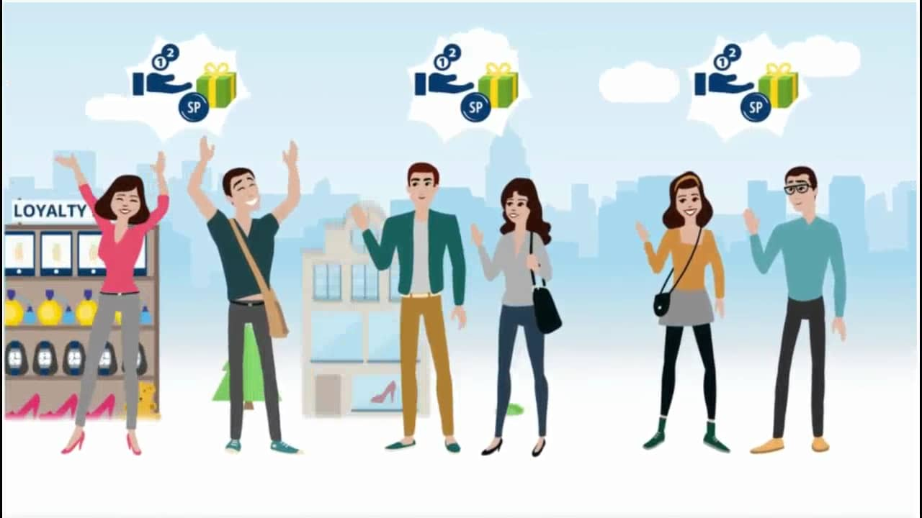
Objectives
Create a android mobile application-ConestogaBuy
Create a user-friendly environment for Conestoga faculty/students where they can connect with one another
Build a system based on trust within the community where people can sell/buy stuff or find renting spaces
Save time and resources
Accessibility to information quicker

Slide 4
KEY FEATURES
Easy to navigate and user-friendly
Accessible to all faculty and students of Conestoga college-Login required
Will have a trust star rating from 1 to 5 for sellers-helps buyer make smart decisions
User will be able to view posts through his friends connections on his feed

Slide 5
Our roles in the project:
Sukriti Sharma- Front End developer
Documentation
Building the user interface
Coding
MuthuKumar Kandasamy-Lead Programmer
Documentation
Coding
User and Database design
Elizabeth Mathew-Database Specialist
Documentation
User and Database design
Coding

Slide 6
Technical architecture
Use Android Studio to develop app
Java
XML
SQLite
JavaScript

Slide 7
THANK YOU!

